Slide 1

Building Features in Triage
Rayid Ghani

Slide 2
Scope
Data
Exploration
Modeling
Get Data
Store Data
Link Data
Rows
Features
Labels
Model Selection
Train-Test Splits
Performance Metrics
Model Interpretation
Entities
temporal
Spatial
…
Models
Dealing with Bias and Fairness
Field Trial Design
Deployment
Monitoring
Goals, Actions, Data, Analysis, Ethics

Slide 3
Reminders
This week:
Tomorrow: Group Check-Ins
Thursday: Time for group work

Slide 4
Plan for the week
What you should be discussing this week within your team
  Temporal configuration
  Features
What you should be building this week
  Implementing Features in TriageGetting comfortable with running triage
  Implementing baselines in Triage
  Finalizing temporal parameters

Slide 5
Before we start: How many feature columns does this make?
prefix: 'bookings'
knowledge_date_column: ’release_date’
aggregates:
- quantity: {total: '*'}
metrics: ['count']
- quantity: 'days_in_jail'
metrics: ['sum', 'avg', 'max']
categoricals:
- column: 'charge_class'
choices: ['felony',
'misdemeanor', 'summary']
metrics: ['sum', 'max']
intervals: ['3 months', '1 year’, '5 years', 'all']

Slide 6
40?
Aggregates
Categoricals
Per interval
Total
(1 × 1) + (1 × 3)
= 4
3 × 2
= 6
4 + 6
= 10
10 × 4
= 40
quantities × metrics
choices × metrics, one-hot first
every interval repeats all of them

Slide 7
There are no static features
Every feature in triage is a temporal aggregate: a feature created as of a date, only from what was known by then.
When did your system know this? Rows after the as-of date are excluded.
A knowledge date
An entity can have many rows by then. sum, max, avg, count collapse them to one number.
A metric
How far back to look. 'all’ includes all history up to the as-of date.
A window

Slide 8
Even age is an aggregate
{collate_date} is the as-of date
prefix: 'demos'
from_obj: |
Triage substitutes it per row. Age is recomputed at every as of date, not stored once.
(select entity_id, birth_date,
greatest(birth_date,'2011-01-01')
as dob
greatest()
from clean.demographics) as dems
A birth date often falls before feature_start_time. That record may be before the feature window and age comes back null for everyone born too early.
knowledge_date_column: 'dob'
aggregates:
- quantity:
age: "extract(year from age(
Still needs an aggregation metric
'{collate_date}'::date,
birth_date::date))"
One row per person, so max is just to select the one value.
metrics: ['max']
intervals: ['all']

Slide 9
Anatomy of a block
Key | What it decides | Where it goes wrong
prefix | Name of the feature table and every column in it | Long prefixes can exceed the 63-char postgres limit
from_obj | A table, or a query with an alias. Must yield entity_id and a date | Joins here run once every as-of date so keep speed in mind
knowledge_date_column | When the information became known to the system | leakage.
aggregates | Numeric quantities, each with its own metrics | A quantity can be any SQL expression, including CASE
categoricals | One-hot per record, then aggregated | Including all values may create 1000s of freatures
intervals | Lookback windows | Not spanning a good range – from recent to all.
*_imputation | What a missing value becomes | Selecting bad defaults and forgetting to specify the exceptions

Slide 10
Triage will create feature names automatically
{prefix}_entity_id_{interval}_{quantity}_{metric}
bookings_entity_id_1y_days_in_jail_sum
bookings_entity_id_all_charge_class_felony_max
The interval string is copied from the yaml
Postgres truncates at 63 characters
'1 year' and you get a column called ..._1 year_total_count with a space in the name. You may want to abbreviate to '1y' instead.
Longer names will give you triage errors
Fix: shorter prefixes, or recode the category values.

Slide 11
Imputations
type | Does | Typical uses
zero | Fills 0, keeps the flag | Counts and sums.
mean | Column average, within the as-of date | Averages and rates
constant | Fills a value you give | “Days since last event” with no event — fill 999999, not 0
null_category | Sets the _NULL one-hot column to 1 | Categoricals. “No category” becomes its own category.
binary_mode | Fills the window’s majority value | 0/1 flags where you want the common case
zero_noflag | Fills 0, no flag column | You are certain absence means zero and want fewer columns. Good. Default for events
error | Stops the run on any null | You believe the column is complete. Excellent way to find out you’re wrong.
Set aggregates_imputation: {all: ...} as the fallback, then override per metric where absence means something different.

Slide 12
Some recipes
From Triage cookbook
Recipe | The trick | Metric
Count events | quantity: {total: '*'} | count
Did it ever happen | A 0/1 column, or a CASE expression | max
How many of this kind | CASE WHEN type='X' THEN 1 ELSE 0 END | sum
Category breakdown | categoricals + choice_query | sum, max
Age at prediction | age('{collate_date}', dob) | max
Days since last event | '{collate_date}'::DATE - event_date | min
Gap between events | LAG() window in from_obj | avg, min, max

Slide 13
An example
The expression gives one number per record
prefix: 'days_since'
Days elapsed between the as-of date and that event.
from_obj: "(SELECT entity_id, event_date
FROM staging.events) AS e"
min picks the most recent
knowledge_date_column: 'event_date'
Smallest gap = latest event. Swap to max and you get days since the first one.
aggregates:
- quantity:
last_event:
"'{collate_date}'::DATE
- event_date::DATE"
999999 for imputation (and a flag gets created)
imputation:
min:
type: 'constant'
value: 999999
'all' because recency is history
metrics: ['min']
A 1-year window would report “never” for anyone whose last event was 13 months ago.
intervals: ['all']

Slide 14
You can see feature values in the database (and compute manually to check)
-- what triage says
SELECT bookings_entity_id_1y_total_count
FROM features.bookings_aggregation_imputed
WHERE entity_id = 12345
AND as_of_date = '2023-01-01';
-- what you compute yourself
SELECT COUNT(*)
FROM staging.bookings
WHERE entity_id = 12345
AND booking_date < '2023-01-01'
AND booking_date >= '2023-01-01'::date
- interval '1 year';

Slide 15
Features in triage
All features are temporal aggregates, reflecting the nature of the data we typically get. Even gender, race, etc. can be a function of time (but may not be captured as such sometimes)
Need to specify what data you’re using and when that information was known
Need to specify how you’ll handle missingness explicitly
YAML structure can take a little getting used to, but powerful for specifying many aggregations over many time frames in compact format

Slide 16
Features in triage
Features get defined in blocks (feature groups) – each feature group comes from a data source (called from_obj and all features in that feature group share a prefix
from_obj : can be a table or sql query and needs a field for entity_id and a knowledge_date_column field that specifies when that event happened

Slide 17
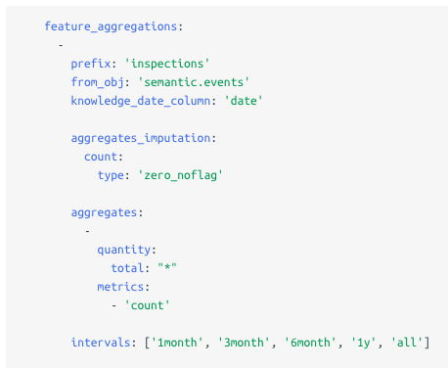
Features in triage – aggregate features
Naming Prefix shared by all the features in this group
Table or SQL snippet (used to generate the feature)
Date field specifying when the event happened
Imputation method for missing data - default for this group (each feature can override this)
Column or SQL snippet and aggregation function
Historical time periods for aggregation

Slide 18
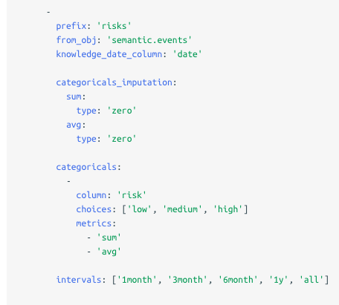
Features in triage: Categorical features
Similar structure for categoricals
Specify categorical values as a list or through a query (such as select distinct value from tablename)

Slide 19
Features in triage: Naming Conventions
For aggregates:
{prefix}_entity_id_{interval}_{quantity}_{metric}
For categoricals:
{prefix}_entity_id_{interval}_{quantity}_{value}_{metric}

Slide 20
Features in triage: Naming Conventions
For aggregates:
{prefix}_entity_id_{interval}_{quantity}_{metric}
For categoricals:
{prefix}_entity_id_{interval}_{quantity}_{value}_{metric}
Important note:
Even categoricals need to be aggregated over time!

Slide 21
Features in triage: Aggregaton and Imputation
Aggregation functions available: 'min', 'max', 'sum', 'avg', 'stddev'
Imputation options: need to be defined at least for each feature group. For eacjh feature group, there can be default imputation methods defined for aggregate and categorical features, or at any level below that (for each aggregation function or for each feature generated)
      Mean
      Zero_noflag
      Constant value
      Zero
      null_category
      binary_mode
      error

Slide 22
Common Features
Categorical features
  Dummy for all values
  Dummy for selected values
Continuous features – aggregates over the past X time
Special types of features
  Age Feature
  Days since last event (by type) – min
  Days since first event (by type) – max
  Days between events (by type) – min, max, avg, stddev (Days between inspection cases in San Jose)

Slide 23
Triage Detour

Slide 24
Features in triage: Some Examples
https://dssg.github.io/triage_cookbook/configure/features.html
Liver disease prediction project
Kidney disease prediction project
Homelessness prevention project

Slide 25
Features in triage: Some Considerations
No built-in way to do “most recent value” (need to pre-compute)
Single/identical values still considered aggregates (can just take “max”)
Categoricals get aggregated, too (one-hot encoded first)
Postgres column length limits / truncation
Need to specify imputation strategy for all features (can do at aggregate-level)
May want to pre-compute especially computationally expensive features

